Slide 1
Bootstrap, JQuery, Sass and Deployment Website

Slide 2
Objectives
Write Bootstrap JS component controls using jQuery and JavaScript
Develop CSS code using preprocessors like Less and Sass
Develop task automation using NPM Scripts

Slide 3
Bootstrap and JavaScript

Slide 4
Bootstrap and JavaScript
Bootstrap’s JavaScript support is through JS Plugins
Plugins written based on Jquery
Plugins can be individually included

Slide 5
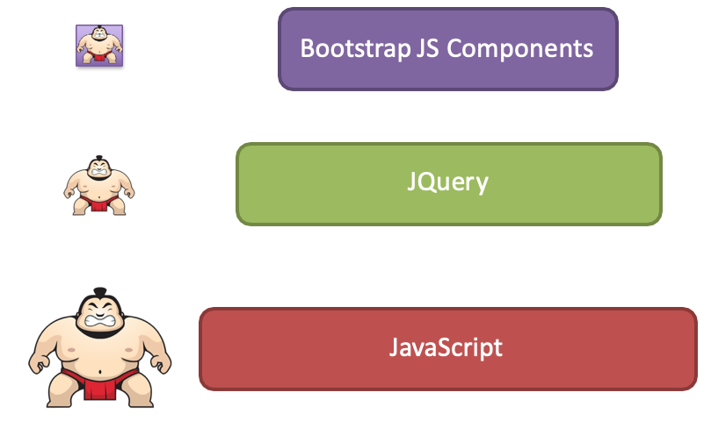
Bootstrap and JavaScript

Slide 6
Bootstrap JS Components
JS components can all be used without writing a single line of JavaScript:
data-* attributes (e.g., data-toggle, data-spy)
Straightforward approach to use plugins
We will explore this approach in this module
Full JS API available if needed
Need to know JQuery syntax and JavaScript

Slide 7
JQuery

Slide 8
Jquery
Lightweight Javascript library
Feature-rich:
HTML/DOM manipulation
CSS manipulation
HTML Event methods
Effects and animations
AJAX
Bootstrap JS components build upon JQuery

Slide 9
JQuery Syntax
$(selector).action()
$: define/access JQuery
(selector): to query and find HTML elements
action(): action to be performed on the element(s)
e.g., $(“p”).hide(), $(“#mycarousel”).carousel(‘pause’)

Slide 10
Bootstrap JQuery Example
<script>
$(document).ready(function(){
$('[data-toggle="tooltip"]').tooltip();
});
</script>

Slide 11
JQuery Selectors
Any HTML element e.g., “p”, “button” etc.
Using an #id, e.g., “#myCarousel”
Class, e.g., “.btn”, “.btn.btn-default”
Attribute, e.g., “[href]”, “[data-toggle=“tooltip”]”
Current element: $(this).
And a lot more . . .

Slide 12
JQuery Events
User’s interactions on a web page causing DOM events:
Mouse: click, dblclick, mouseenter, mouseleave
Keyboard: keypress, keydown, keyup
Form: submit, change, focus, blur
Document, Window: load, resize, scroll, unload
JQuery Event Methods: e.g., ready(), click(), dblclick(), mousedown(), on()

Slide 13
Example: Bootstrap Carousel
Data Attributes
data-slide=“prev|next”
data-slide-to=“0|1|2|…”
data-ride=“carousel”
data-interval=5000

Slide 14
Example: Carousel
JavaScript based control:
$(‘.carousel’).carousel();
e.g.
$(‘.carousel’).carousel({ interval:2000});

Slide 15
Example: Carousel
Other controls:
.carousel(‘cycle’): cycle items left to right
.carousel(‘pause’): stops the carousel
.carousel(number): cycles the carousel to a particular frame number specified
.carousel(‘prev’): previous item
.carousel(‘next’): next item

Slide 16
Example: Carousel
Events:
slide.bs.carousel: fires when the slide instance method is invoked
slid.bs.carousel: fired when the carousel has completed its slides transition
Use with the .on() method:
$(“#myCarousel”).on(‘slide.bs.carousel’, function() {
// do something
})

Slide 17
Exercise 18: Bootstrap and JQuery
Add two buttons to the Carousel to pause/resume the slide transition
Activate the buttons using JavaScript

Slide 18
CSS Preprocessors
Less and Sass

Slide 19
CSS
CSS is great for defining styles and repeatedly applying them to various HTML elements
CSS is limited when it comes to features like defining variables, nesting selectors, expressions, functions
Maintainability suffers

Slide 20
CSS Preprocessors
Several popular:
Less
Sass (Syntactically Awesome Style Sheets), and
Scss (Sassy CSS) syntax examined in this course
Stylus
All are compiled into traditional CSS syntax automatically before use in a web page
We will examine Less and Sass briefly
Bootstrap 3 used Less, but Bootstrap 4 migrated to use Sass

Slide 21
Typical CSS Preprocessors Features
Variables
Nesting selectors
Mixins
Functions & Expressions

Slide 22
Variables
Less
@lt-gray: #ddd;
@background-dark: #512DA8; @carousel-item-height: 300px;
.navbar-inverse {
background:@background-dark;
}
.carousel .carousel-item {
height: @carousel-item-height;
}
variables can also have scope
Scss
$lt-gray: #ddd;
$background-dark: #512DA8;
$carousel-item-height: 300px;
.navbar-inverse {
background:$background-dark;
}
.carousel .item {
height: $carousel-item-height;
}

Slide 23
Nesting
Less
@background-dark: #512DA8; @carousel-item-height: 300px;
.carousel {
background:@background-dark;
.carousel-item {
height: @carousel-item-height; img {
position: absolute; top: 0;
left: 0;
min-height: 300px;
}
}
}
Scss
$background-dark: #512DA8;
$carousel-item-height: 300px;
.carousel {
background:$background-dark;
.carousel-item {
height: $carousel-item-height;
img {
position: absolute; top: 0;
left: 0;
min-height: 300px;
}
}
}

Slide 24
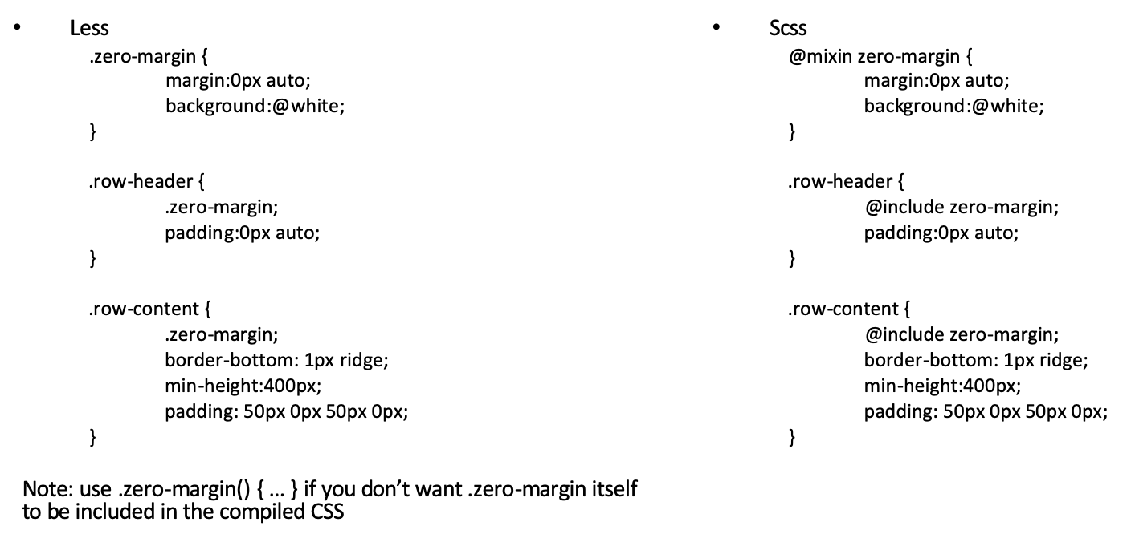
Mixins
Mixins can hold multiple CSS declarations unlike variables

Slide 25
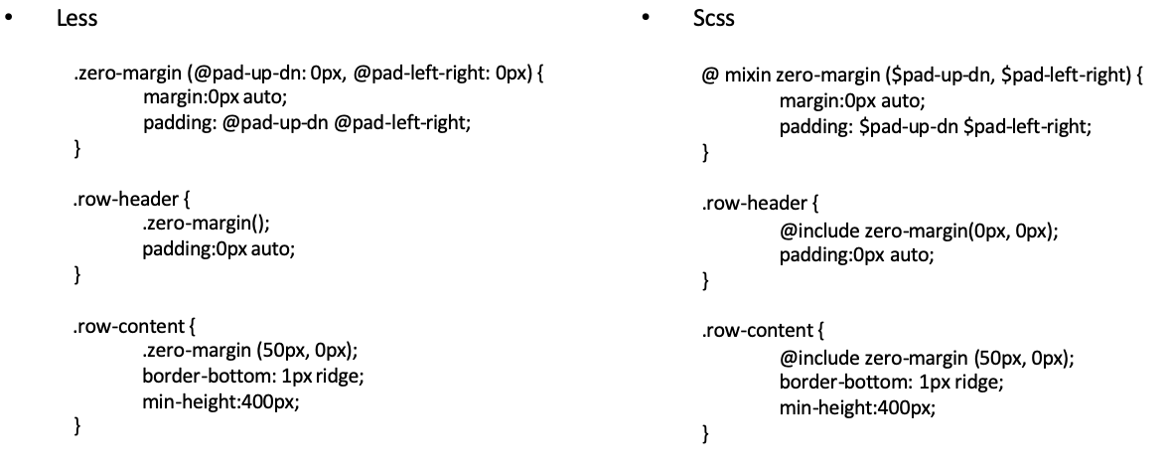
Mixins with Parameters

Slide 26
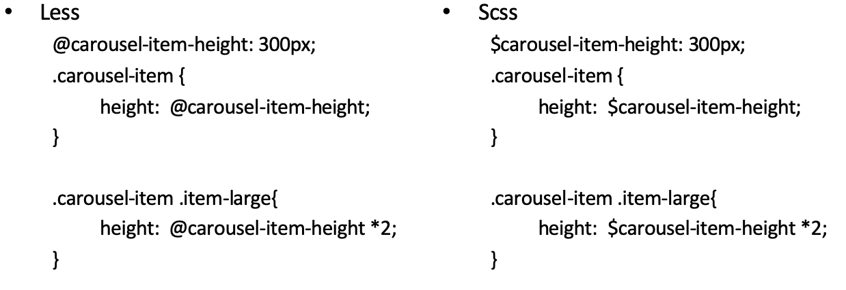
Mathematical Operations

Slide 27
Other Features
Functions: math, list, string, color, color operations, color blending etc.
See the documentation
Imports
e.g., in both Less and Sass: @import “foo”

Slide 28
Exercise 19: Less
Simple exercise to write a Less file
Generate the corresponding CSS file
Use lessc compiler

Slide 29
Exercise 20: Scss
Write Scss code using many of the features of Scss
Automatically convert the Scss code into CSS

Slide 30
Building and Deployment

Slide 31
Web Development and Deployment
Web development and deployment involves a lot of repetitive tasks
The DRY (do not repeat yourself) principle
Need for build tools to automate tasks

Slide 32
CSS Tasks
Compiling Sass or Less into CSS
Running Autoprefixer to add any vendor prefixes that are needed
Minification: removing unnecessary characters (white spaces, newlines, comments) from source code without compromising functionality
Concatenation

Slide 33
JavaScript Tasks
JSHint: Checking JavaScript code for errors and potential problems (static code analysis)
Concatenation
Uglification: minification + mangling (reduce local variables to single letters)
Rechecking for errors

Slide 34
Other Tasks
Images: optimizing files to reduce file size
Watch: watching for changes in files and automatically rerunning tasks
Server and Livereload
Testing
Building your site for deployment

Slide 35
NPM Scripts
“scripts” property in the package.json file:
Several supported
“start”: run by the npm start command
Of particular interest to us is to use the ”npm run” approach to run scripts
e.g., ”npm run scss”, “npm run lite”

Slide 36
Exercise 21: NPM Scripts
Learn how to configure NPM scripts in package.json to execute several building and deployment tasks

Slide 37
Summary
How to write Bootstrap JS component controls using jQuery and JavaScript
Understand develop CSS code using preprocessors like Less and Sass
How to automate your web development tasks and deploy using NPM scripts

